Slide 1
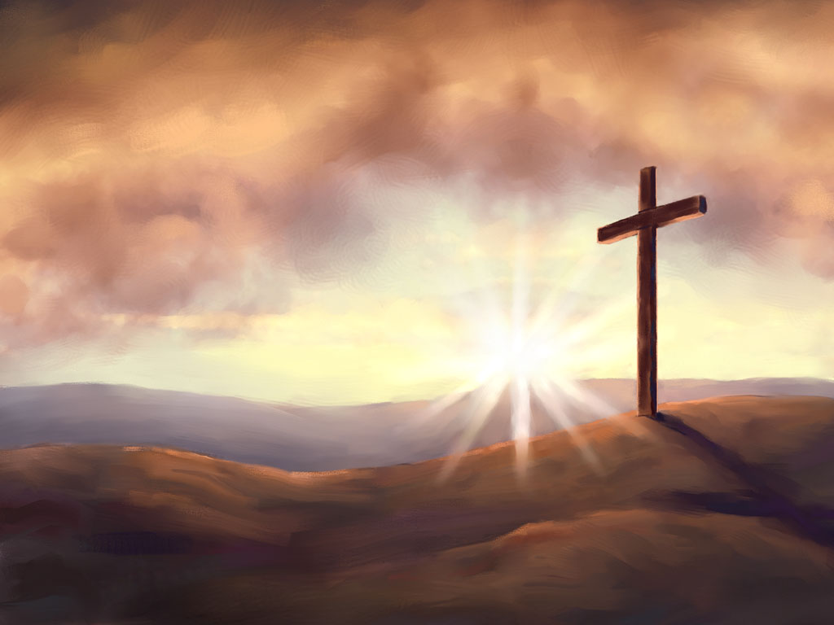
Gratitude – Unity – Wholeness – LIFE
Key Texts:
Colossians 3:12-15
Ephesians 4:1-6
1Timothy 6:12

Slide 2
Gratitude – Unity – Wholeness – LIFE
⁵ Put to death therefore what is earthly in you: sexual immorality, impurity, passion, evil desire, and covetousness, which is idolatry. ⁶ On account of these the wrath of God is coming. ⁷ In these you too once walked, when you were living in them. ⁸ But now you must put them all away: anger, wrath, malice, slander, and obscene talk from your mouth.
Colossians 3:5-8 ESV

Slide 3
Gratitude – Unity – Wholeness – LIFE
⁹ Do not lie to one another, seeing that you have put off the old self with its practices ¹⁰ and have put on the new self, which is being renewed in knowledge after the image of its creator. ¹¹ Here there is not Greek and Jew, circumcised and uncircumcised, barbarian, Scythian, slave, free; but Christ is all, and in all.
Colossians 3:9-11 ESV

Slide 4
Gratitude – Unity – Wholeness – LIFE
¹² Put on then, as God's chosen ones, holy and beloved, compassionate hearts, kindness, humility, meekness, and patience, ¹³ bearing with one another and, if one has a complaint against another, forgiving each other; as the Lord has forgiven you, so you also must forgive.
Colossians 3:12,13 ESV

Slide 5
Gratitude – Unity – Wholeness – LIFE
¹⁴ And above all these put on love, which binds everything together in perfect harmony.
¹⁵ And let the peace of Christ rule in your hearts, to which indeed you were called in one body. And be thankful.
Colossians 3:14-15 ESV

Slide 6
Gratitude – Unity – Wholeness – LIFE
²⁰ “I do not ask for these only, but also for those who will believe in me through their word, ²¹ that they may all be one, just as you, Father, are in me, and I in you, that they also may be in us, so that the world may believe that you have sent me.
John 17:20,21 ESV

Slide 7
Gratitude – Unity – Wholeness – LIFE
“God is leading out a people to stand in perfect unity upon the platform of eternal truth … God designs that His people should all come into the unity of faith. The prayer of Christ just prior to His crucifixion was that His disciples might be one, even as He was one with the Father, that the world might believe that the Father had sent Him.”
EG White, Testimonies Vol. 4, p. 17

Slide 8
Gratitude – Unity – Wholeness – LIFE
“This most touching and wonderful prayer reaches down the ages, even to our day; for His words were:
‘Neither pray I for these alone, but for them also which shall believe on Me through their word.’
How earnestly should the professed followers of Christ seek to answer this prayer in their lives.”
EG White, Testimonies Vol. 4, p. 17

Slide 9
Gratitude – Unity – Wholeness – LIFE
Unity With Other Christians
We can work with them on common social interests.
If we do unite with them, we must do so in a way that will not compromise our beliefs or practices.
We can and should use this unity to share with others the precious truths with which we have been blessed.

Slide 10
Gratitude – Unity – Wholeness – LIFE
Love in Action
Love God and Love Others - a wonderful standard.
Jesus’ life - a practical demonstration of love in action.
The whole work of grace is one of continual service of love, of self-denying, self-sacrificing effort.
This other-focused theme (agape love) Jesus shared fosters wholeness and creates opportunities to share God’s love.

Slide 11
Gratitude – Unity – Wholeness – LIFE
“Unity” – Letter of Paul to the Ephesians
Letter focused around unity. Diverse congregation
Paul’s concept of unity has two dimensions:
unity in the church, where Jews and Gentiles are brought together in one body – Jesus Christ Himself.
unity in the universe, in which all things in heaven and earth find their ultimate oneness in Christ.

Slide 12
Gratitude – Unity – Wholeness – LIFE
Walking Worthy of Your Calling in Christ
Read Ephesians 4:1-3
What are some ways we are to walk worthy of our calling in Christ?

Slide 13
Gratitude – Unity – Wholeness – LIFE
Why is this important in our Christian Walk?
The practical outcome of these virtues and graces in the Christian’s life helps us to “keep the unity of the Spirit in the bond of peace”.
All these attributes are rooted in love.
The active practice of love for others preserves relationships and promotes peace and unity in the Christian community and beyond.
Unity in the church manifests God’s love in unique ways that others can witness.

Slide 14
Gratitude – Unity – Wholeness – LIFE
⁴ There is one body and one Spirit—just as you were called to the one hope that belongs to your call— ⁵ one Lord, one faith, one baptism, ⁶ one God and Father of all, who is over all and through all and in all.
Ephesians 4:4-6 ESV
What is the crucial theme in these verses?

Slide 15
Gratitude – Unity – Wholeness – LIFE
Christianity is a religion of relationships: relationship with God and with one another. Christianity cannot be lived in a vacuum.
As Christians, we are to be guided by God in three ways:
First, we must be looking upwardly to God Himself, learning and growing in a personal relationship with Christ.
This God-focused life changes us inwardly by the power of the Holy Spirit, transforming our lives.
Then, and only then, can we have an outwardly focused life, sharing God with others in Christ-like ways.

Slide 16
Gratitude – Unity – Wholeness – LIFE
Overview of Ephesians 5
The first three sections of this chapter: Walk in Love, Walk in Light, Walk in Wisdom.
Paul is urging the Christian to be submitted to one another.
Humility and Thoughtfulness - result of the Spirit living in our hearts. It is a gift of the same Spirit, who is the bond of unity in Christ.
Submission is an inner quality that outwardly expresses our reverence for Christ and His sacrifice for us.

Slide 17
Gratitude – Unity – Wholeness – LIFE
Give me the world or Give me Christ
Give me the World: Remain on our own throne in a state of worldliness filled with self-centeredness.
OR
Give me Christ: Submit our lives that day to Jesus, and invite Him to sit on the thrones of our lives, in a state of godliness filled with agape love, a self-sacrificing love that is outward-centered.

Slide 18
Gratitude – Unity – Wholeness – LIFE
Review:
Gratitude and thanksgiving to God is the basis of unity, the model of Christ and the desire He has for our lives, which leads to wholeness and true fulfillment. How is all of this possible? Only one way – through Jesus Christ who has offered us life, eternal life, through the gift of His life on the cross.

Slide 19
Gratitude – Unity – Wholeness – LIFE
Unity in the Body of Christ – Early Church:
Fellowshipped with one another
Learned about Jesus
Spent time in prayer and the breaking of bread
Spent time in Worship
Relational Evangelism!

Slide 20
Gratitude – Unity – Wholeness – LIFE
⁶ But godliness with contentment is great gain, ⁷ for we brought nothing into the world, and we cannot take anything out of the world.
⁸ But if we have food and clothing, with these we will be content.
⁹ But those who desire to be rich fall into temptation, into a snare, into many senseless and harmful desires that plunge people into ruin and destruction.
¹⁰ For the love of money is a root of all kinds of evils. It is through this craving that some have wandered away from the faith and pierced themselves with many pangs.
1 Timothy 6:6-10 ESV

Slide 21
Gratitude – Unity – Wholeness – LIFE
¹¹ But as for you, O man of God, flee these things. Pursue righteousness, godliness, faith, love, steadfastness, gentleness.
¹² Fight the good fight of the faith. Take hold of the eternal life to which you were called and about which you made the good confession in the presence of many witnesses.
1 Timothy 6:11,12 ESV

Slide 22
Gratitude – Unity – Wholeness – LIFE
Main Idea:
The focus on living with gratitude and this unity to which our God has called us is critical within the Body of Christ.
Unity in Christ produces a wholeness that we, in our own efforts, would never be able to accomplish.
Wholeness in our relationship with God, with ourselves and with others prepares us for the eternal life that Jesus has secured for us.

Slide 23
Gratitude – Unity – Wholeness – LIFE
Closing Hymn:
#206
Face to Face

